Slide 1
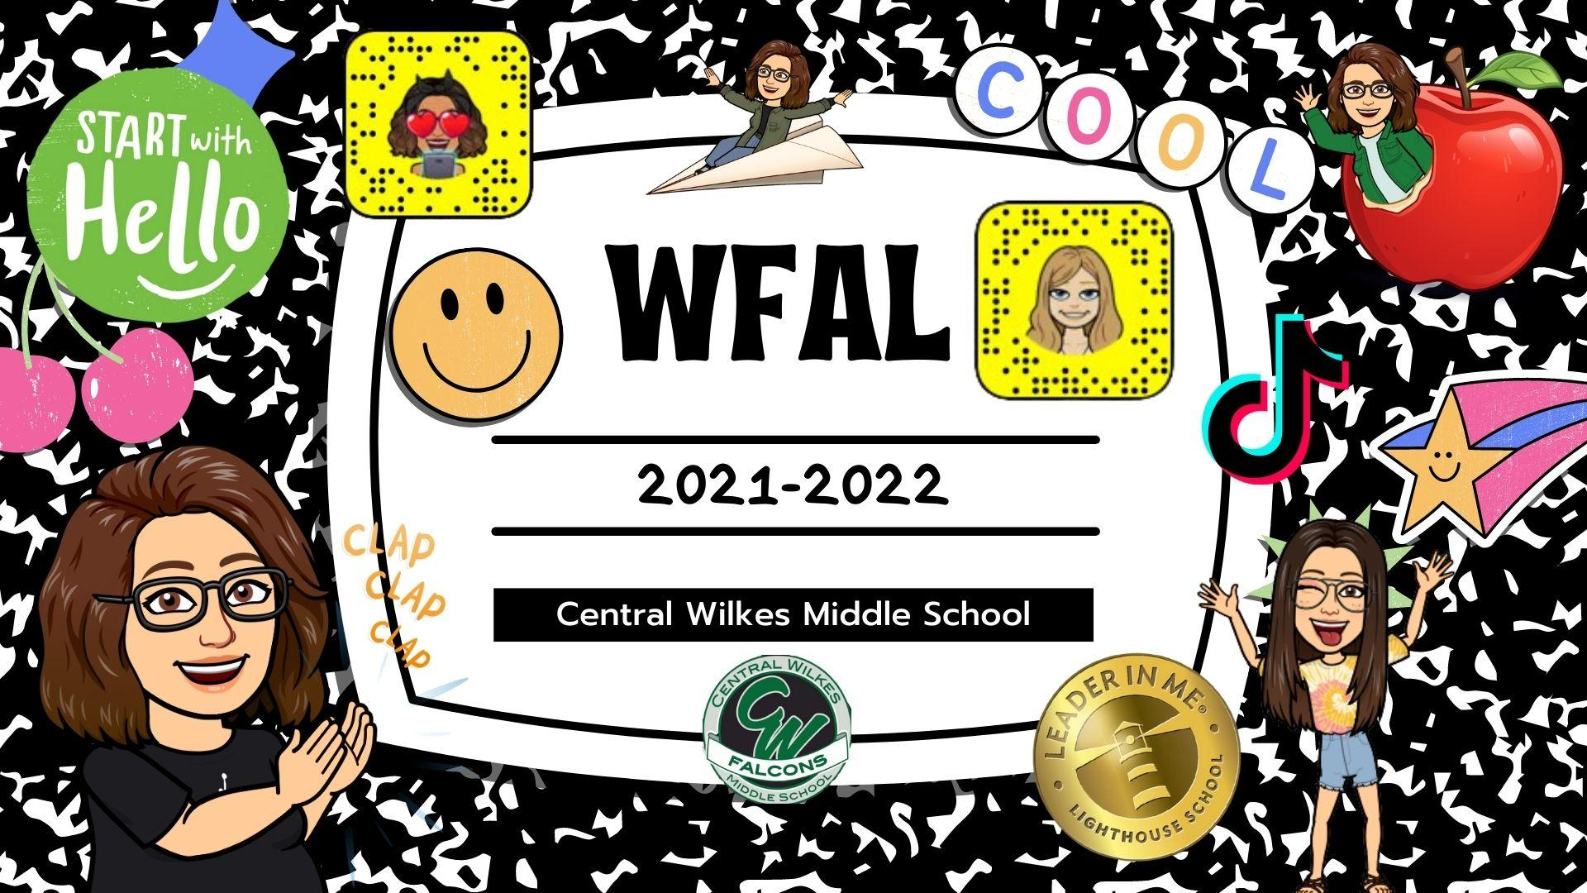

Slide 2
Notes:
1-5-22

Slide 3
January
2022

Slide 4
Notes:
12-17-21

Slide 5
Notes:
12-16-21

Slide 6
Notes:
12-15-21

Slide 7
Notes:
12-14-21

Slide 8
Notes:
12-13-21

Slide 9
Notes:
12-10-21

Slide 10
Notes:
12-9-21

Slide 11
Notes:
12-8-21

Slide 12
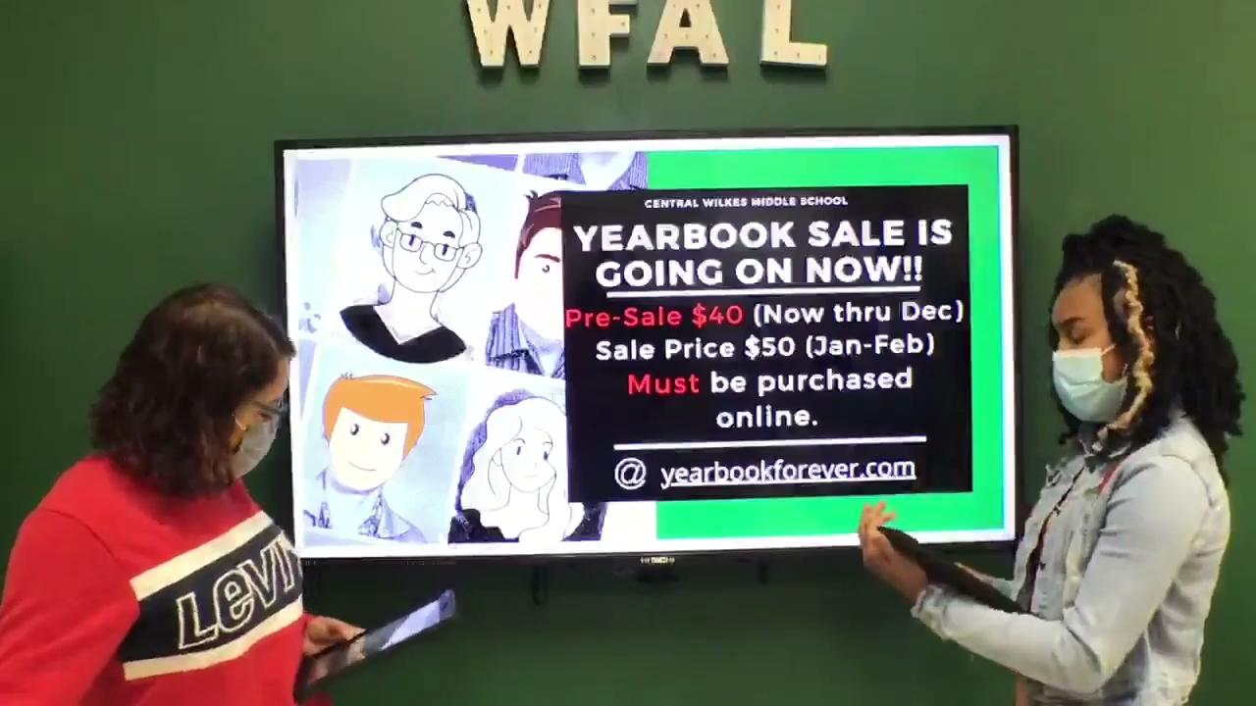
Notes:
12-3-21

Slide 13
Notes:
12-2-21

Slide 14
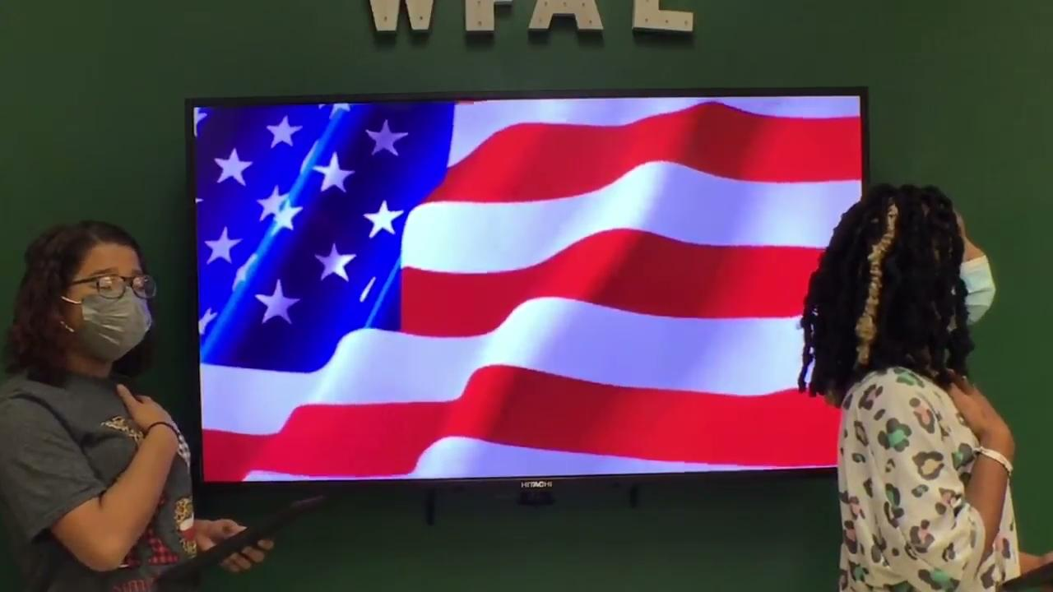
Notes:
12-1-21

Slide 15
December
2021

Slide 16
Notes:
11-30-21

Slide 17
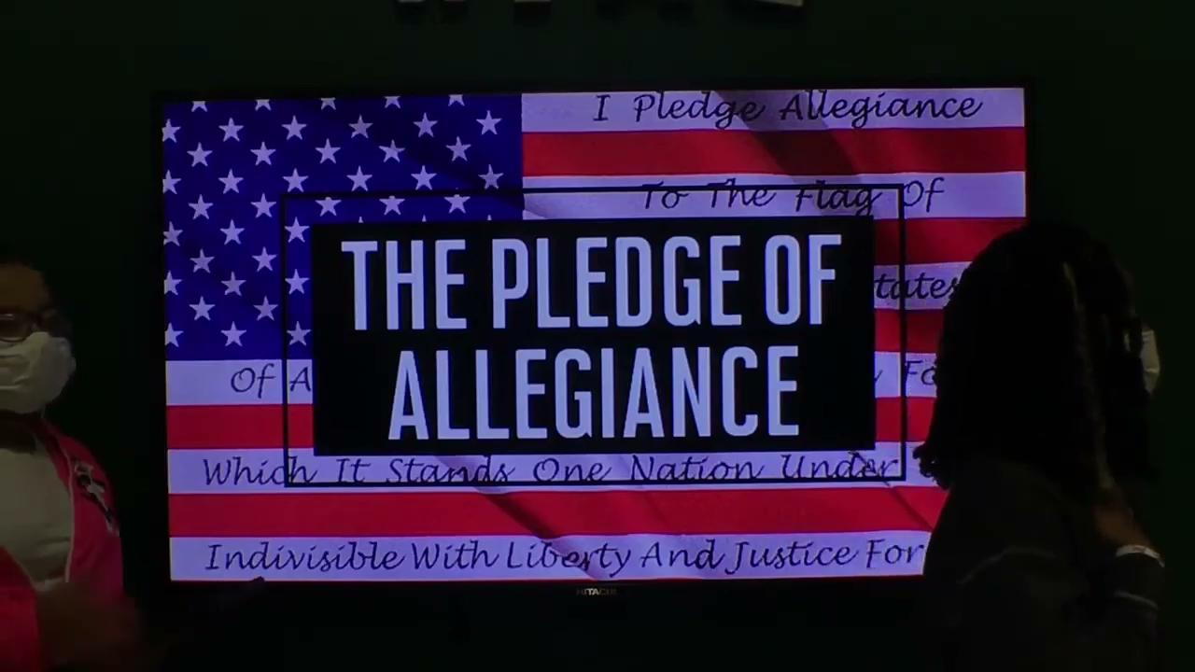
Notes:
11-29

Slide 18
Notes:
11-19-21

Slide 19
Notes:
11-18-21

Slide 20
Notes:
11-17-21

Slide 21
Notes:
11-16-21

Slide 22
Notes:
11-15-21

Slide 23
Notes:
11-12-21

Slide 24
Notes:
11-10-21

Slide 25
Notes:
11-9-21

Slide 26
Notes:
11-8-21

Slide 27
Notes:
11-5-21

Slide 28
Notes:
11-4-21

Slide 29
Notes:
11-3-21

Slide 30
Notes:
11-2-21

Slide 31
November
2021

Slide 32
Notes:
10-30-21

Slide 33
Notes:
10-29-21

Slide 34
Notes:
10-28-21

Slide 35
Notes:
10-27-21

Slide 36
Notes:
10-26-21

Slide 37
Notes:
10-25-21

Slide 38
Notes:
10-20-21

Slide 39
Notes:
10-19-21

Slide 40
Notes:
10-18-21

Slide 41
Notes:
10-15-21

Slide 42
Notes:
10-15-21

Slide 43
Notes:
10-14-21

Slide 44
Notes:
10-13-21

Slide 45
Notes:
10-13-21

Slide 46
Notes:
10-12-21

Slide 47
Notes:
10-11-21

Slide 48
Notes:
test

Slide 49
Notes:
10-8-21

Slide 50
Notes:
10-7-21

Slide 51
Notes:
10-6-21

Slide 52
Notes:
10-5-21

Slide 53
Notes:
10-4-21

Slide 54
Notes:
10-1-21

Slide 55
October
2021

Slide 56
Notes:
9-31-21

Slide 57
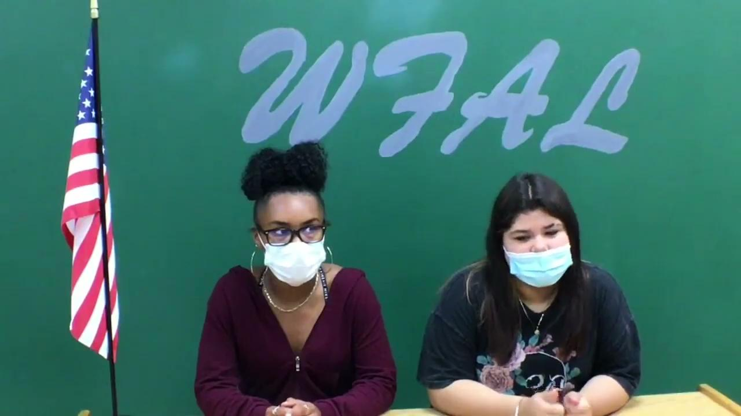
Notes:
9-30-21

Slide 58
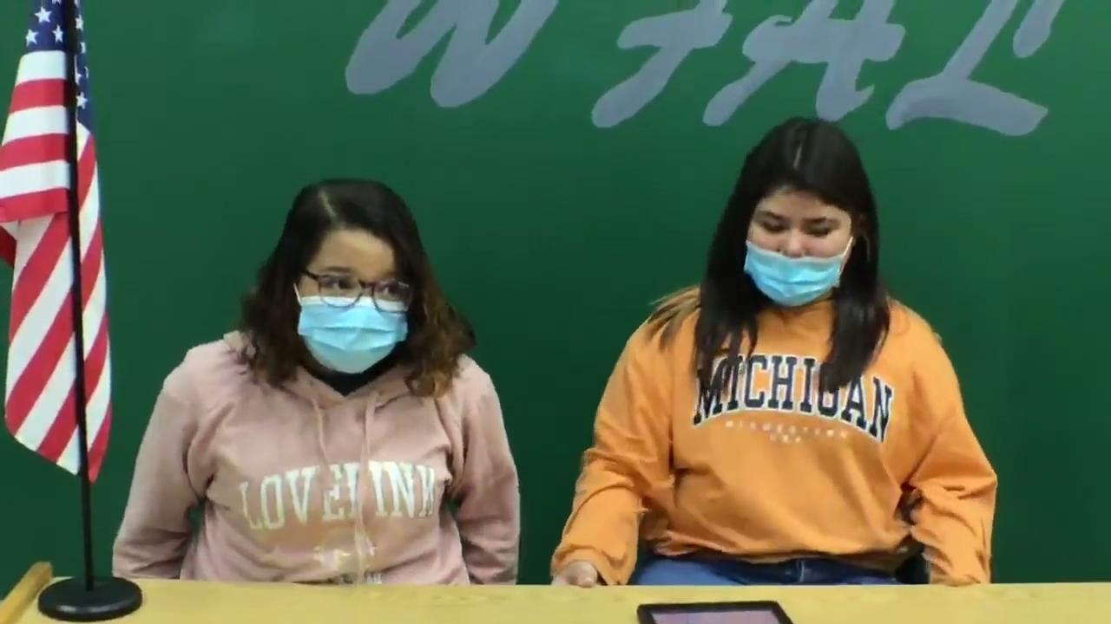
Notes:
9-29-21

Slide 59
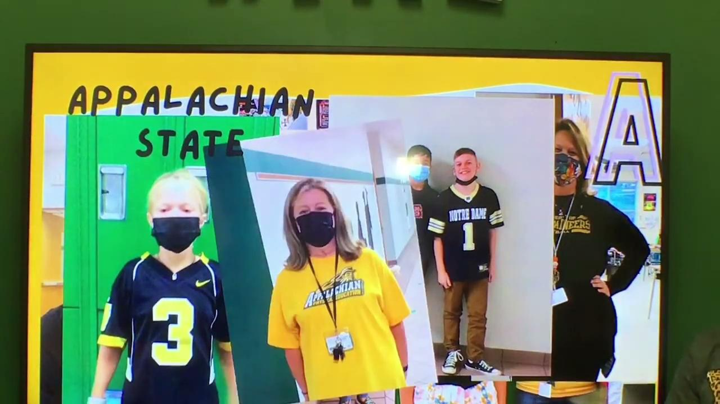
Notes:
9-28-21

Slide 60
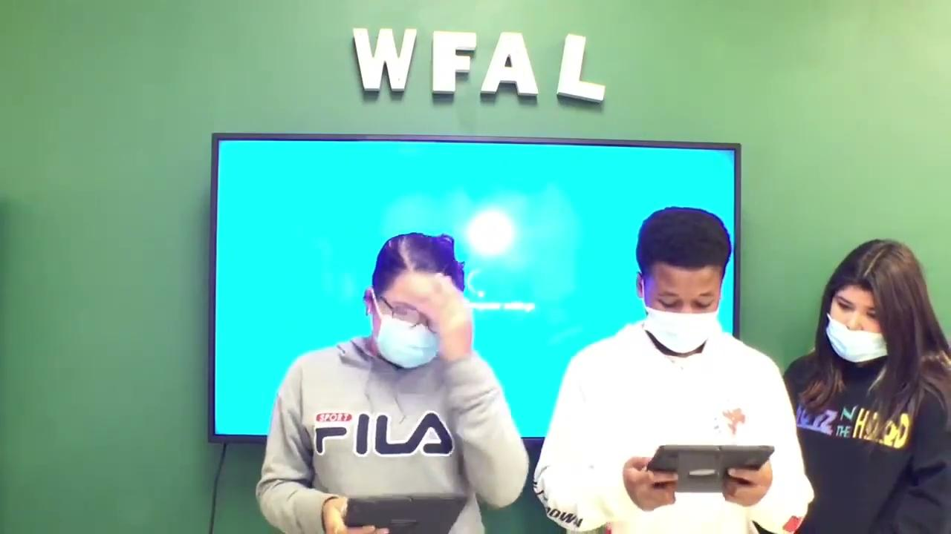
Notes:
9*24*21

Slide 61
Notes:
9-23-21

Slide 62
Notes:
9-22-21

Slide 63
Notes:
9/21/21 BEST ONE YET!!!

Slide 64
Notes:
9/20/21

Slide 65
WeeK #4

Slide 66
Notes:
9/17/21

Slide 67
Notes:
9/16/21

Slide 68
Notes:
9/15/21

Slide 69
Notes:
9/13/21

Slide 70
WeeK #3

Slide 71
Notes:
9/10/21

Slide 72
Notes:
9/9/21

Slide 73
Notes:
9/8/21

Slide 74
Notes:
9/7/21

Slide 75
WeeK #2

Slide 76
Notes:
9/3/21
No good morning of any kind, just jumped right into morning announcements. Good job slowing down with the pledge signers!
D- better job looking up (you did twice during your first announcement, 0 during the responsibility read) as you read, let’s shoot for doubling that per announcement this week!
A- still rocking while you read. I think your body knows you shouldn’t hold that big personality that you have back. More ad libbing the message, less reading, ok? Also, since you participated in the Chorus Preview, you could have added more about what was going to be sung...or bragging on your class/group...anything to make it less scripted. Great job with the quote slide!!
Olivia, great job with transitions with the ipad AND captions!! We will catch that sound thing faster next time! :)
Hannah-Mae, slide transitions are looking good, girl!!

Slide 77
Notes:
9/1/21

Slide 78
September
2021

Slide 79
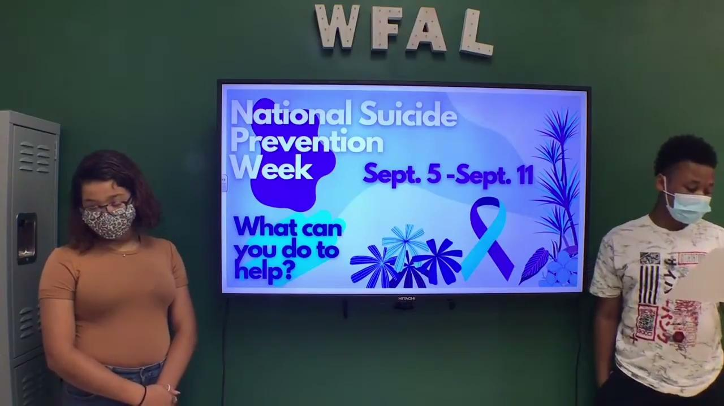
Notes:
8/31/21

Slide 80
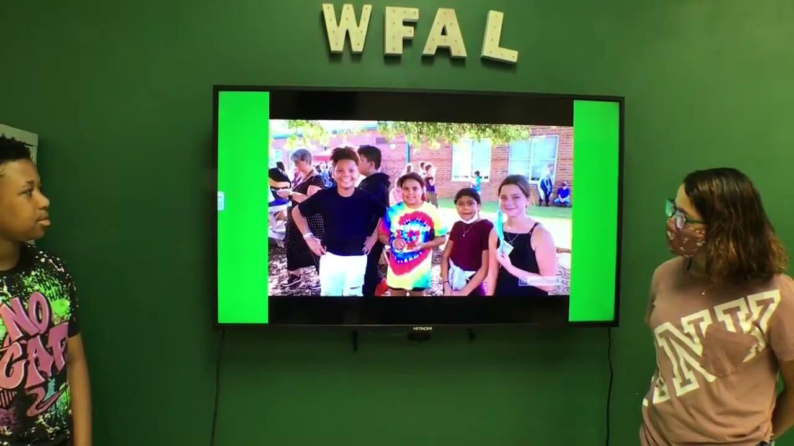
Notes:
8/30/21

Slide 81
WeeK #1

Slide 82
August
2021

